Slide 1
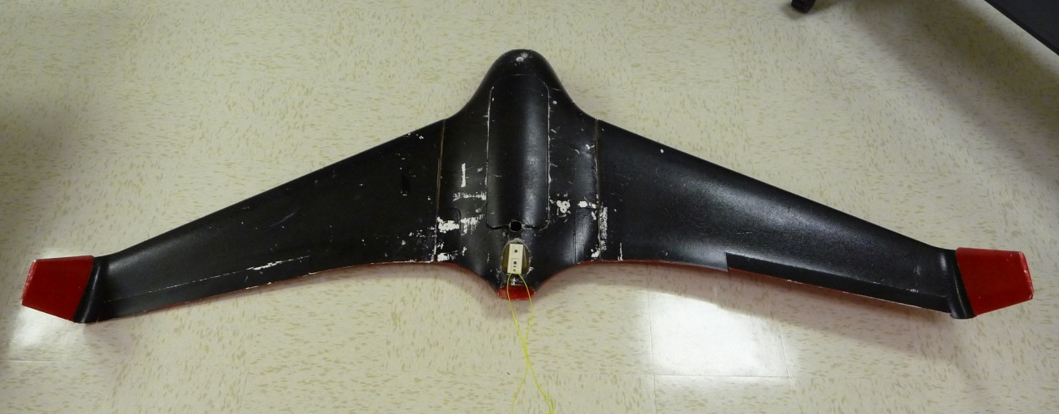
Name of Project Initial Design Review
Put a relevant / catchy picture or graphic on the front!
Sponsor: Name & Affiliation
Faculty Advisor: Name
Choose your own slide design
Place the logo of your sponsoring company here

Slide 2
WARNING!
The picture on the first slide is to put your project into context.
If it’s a relevant picture you’ll need to show it later and at large size & high res
Notes:
DELETE THIS SLIDE WHEN DONE

Slide 3
Project Overview
What are you going to design??
What’s it for?
What are you going to deliver?
Notes:
State the problem and the project in clear terms. Use a graphic if at all possible.

Slide 4
Block Diagrams Example: Auto Cruise Control
Delete these examples when done!
Notes:
DELETE THIS SLIDE WHEN DONE!

Slide 5
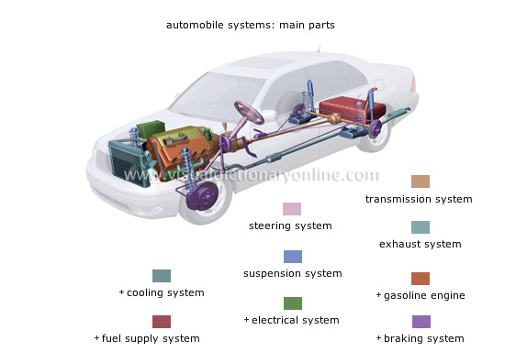
Cruise Control Top Level System
Cruise controls are typically used in an automobile. The driver sets a desired speed and the throttle is varied to stay close to that speed by a control system. One key parameter is how fast the CC responds.
Notes:
Put your project into the larger context.

Slide 6
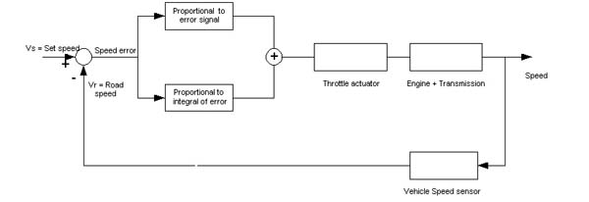
Cruise Control Functional Block Diagram
Automobile applications
Notes:
Show a functional overview of how it works. This applies to software or hardware or mix.

Slide 7
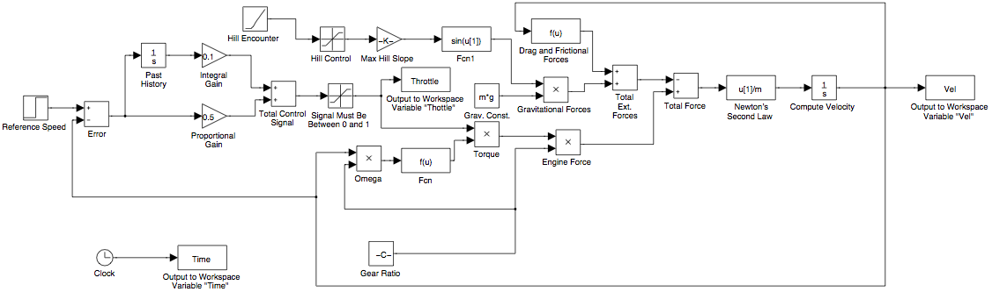
Cruise Control Detail Block Diagram
Give a few lines of detail regarding main features of the system
Notes:
Show deep technical detail. You may need more than one slide. Highlight in yellow the blocks that the team will be designing

Slide 8
Project Goals
Goals of Project
Stretch Goals of Project
List the major goals here
Be concise
Don’t list too many
List the stretch goals here
Be concise
Don’t list too many
Notes:
If no stretch goals then delete the text box on the right, and expand the one on the left. DO NOT ELABORATE ON THE GOALS, JUST STATE THEM QUICKLY AND MOVE ON!!!

Slide 9
Roles & Responsibilities
NAME | ROLE
Sally Supreme, Project Manager | User Interface: Definition, Design & Testing
Bubba Ray Dudley | Analog Design, SPICE Simulation, Breadboarding
Sammy Spectacular | Microprocessor Code, Alpha & Beta Testing, Version Control
Notes:
BRIEF DESCRIPTIONS!!!!! Go over this VERY quickly!

Slide 10
Project-Specific Milestones NOT Course Deliverables
MILESTONE | Completion Date | Person(s)
Be sure to include goals specific to the project, e.g.,
Parts Ordered; PCB initial layout for review; Initial simulations; Breadboard testing; Code Integrated – and so on.
Notes:
List the major milestones. They are milestones SPECIFIC to YOUR project and NOT deliverables for the class!!!

Slide 11
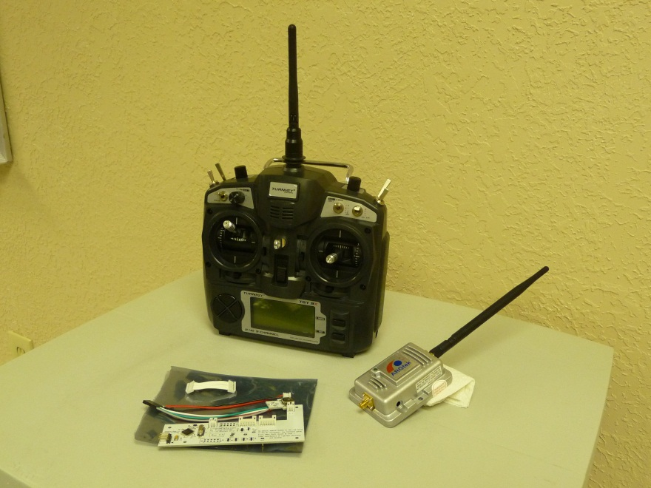
Project Deliverables
Launch system comprised of a high altitude balloon, nichrome wire, and timer
Design and fabricate long-range amplifier and programming board
Assemble glider capable of short term operation
Electronics and Solar Panels connected for ground test
These are examples, write your own!
Notes:
List the MAJOR deliverables only. These are the deliverables for your PROJECT and NOT for the class! E.g., don’t list “Functional Spec” etc.

Slide 12
Functional Specification Review

Slide 13
2.2 Administration Functions
Notes:
If this section is not relevant to your project then delete this slide. If relevant, talk to this slide for no more than 1 minute!

Slide 14
2.3 Error Handling
Notes:
Talk to this slide for no more than 1 minute! Remember: ALL designs must handle errors! You may have to think about what they might be!

Slide 15
2.4 Safety & Security
Notes:
If this section is not relevant to your project then delete this slide. If relevant, talk to this slide for no more than 1 minute!

Slide 16
You may need to have a block diagram – of various levels – available throughout the presentation to illustrate elements of the design!

Slide 17
2.61 – User Interfaces
Notes:
These are interfaces between the USER and your SYSTEM.

Slide 18
2.62 – Software Interfaces
Notes:
These are interfaces between one piece (or language) of software and another due to your design. If this section is not relevant to your project then delete this slide.

Slide 19
2.63 – Hardware Interfaces
Notes:
These are interfaces between two pieces of hardware, e.g., you connected a sensor to a pi. If this section is not relevant to your project then delete this slide.

Slide 20
2.64 – Mechanical Interfaces
Notes:
These are interfaces between two mechanical systems like a motor and a generator. If this section is not relevant to your project then delete this slide. FEW projects have mechanical interfaces.

Slide 21
2.7 Boundary Conditions & Constraints
Notes:
List the boundary conditions and make sure your Sponsor agrees that they are indeed boundary conditions. Talk to this slide for no more than 1 minute!

Slide 22
2.8 Performance
Software Performance Parameters
Function | Description | How Tested
New releases | Arduino software 1.6.6 | When there is a new release the user will be notified by email, following the link and install it: https://www.arduino.cc/en/Main/Software
User interface | Software window loads in four seconds. | A timer is used to verify the load time.
Memory usage | the amount of Operate System memory occupied the application is about 18MB | Observations done from the Windows Task Manager
System reliability | System gives very accurate results. | The measurements are obtained from several different usage instances during testing with codes.
Title bars | Verified , Run , Upload title bars are displayed on the program windows. | Each instance checked for the code is uploaded and verified, and the program is running.
Notes:
This is where you need to spend the majority of your time. You’ll need several slides to cover 2.13.

Slide 23
2.9 Software Platforms
Notes:
What platforms does your system run on? If this section is not relevant to your project then delete this slide. If relevant, talk to this slide for no more than 1 minute!

Slide 24
2.10 Service, Support & Maintenance
Notes:
What platforms does your system run on? If this section is not relevant to your project then delete this slide. If relevant, talk to this slide for no more than 1 minute!

Slide 25
2.11 Expandability or Customization
Notes:
What platforms does your system run on? If this section is not relevant to your project then delete this slide. If relevant, talk to this slide for no more than 1 minute!

Slide 26
Challenges & Concerns
EXAMPLE: Power System Development
Each component is powered at a different voltage level and consume different current – best way to implement?
Obtaining light-weight solar panels with sufficient power output – budgetary constraints
Implementing solar charging during flight
Predicting environmental conditions
Vibration, temperature, wind, pressures, etc.
These are examples, write your own!
Notes:
Word this carefully – OK to ask questions and seek resolution during the IDR. CLASS DELIVERABLES and/or team meetings ARE *NOT* CHALLENGES!!!

Slide 27
Project Progress
Analysis of electronic components completed for:
Weight, Current consumption, operating voltage, power consumption
Research completed for:
Solar power capabilities
Solar power integration
Parts procured:
Power system – Solar panels, batteries, power analyzer
Control system – transmitter, amplifier, antenna, GPS, ESC
Electronic payload – Camera
Mechanical system – Motor, propeller
These are examples, write your own!
Notes:
Go through this at a good pace. You could spend 30 minutes on this alone – don’t. Just give an overview.

Slide 28
Future Tasks
Tasks Planned for the Completion of the project:
Assemble glider
Assemble the electronic components within the glider
Determine which solar panels will function with our power requirements and order them
Program RC controller
Perform test of launch system
Perform preliminary tests with solar cells
These are examples, write your own!
Notes:
High level tasks! DO NOT enter items like, “order 100 ohm resistors.”

